Slide 1
Office of Accessibility 101
Office of Accessibility
The University of Akron
Simmons 105
Notes:
Welcome to Accommodations 101: Testing, presented by the Office of Accessibility at The University of Akron.

Slide 2
Objectives
Participants will:
Learn specific information about the Office of Accessibility
Gain understanding of how the Office of Accessibility functions to provide classroom accommodations to students with disabilities on campus at The University of Akron
Notes:
In this presentation, viewers will learn information about the Office of Accessibility, as well as gain an understanding of a variety of testing accommodations and how to provide students with this accommodation.

Slide 3
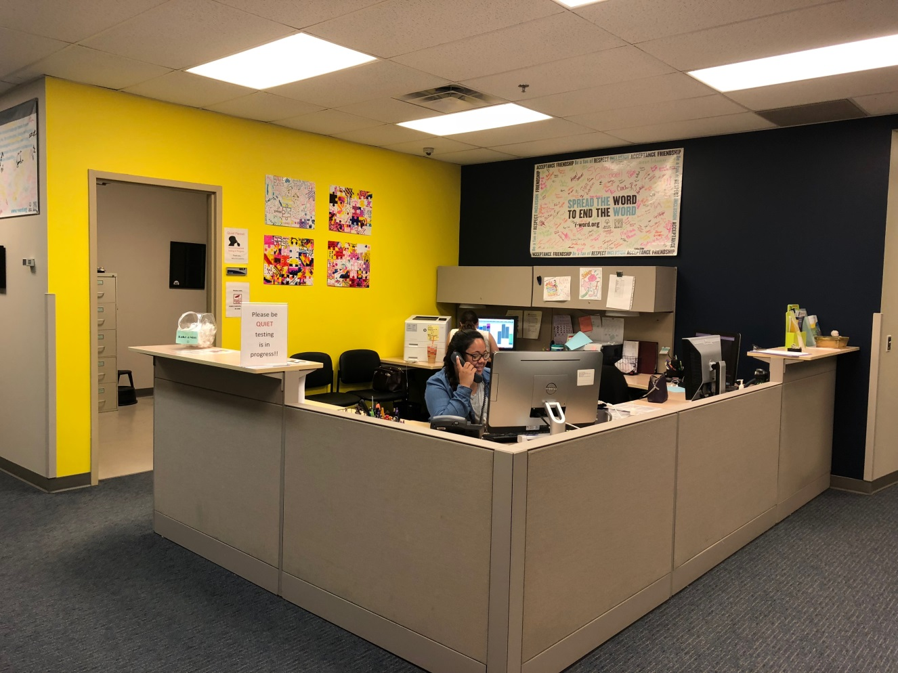
The Office of Accessibility
Simmons Hall 105
Notes:
The Office of Accessibility is located in Simmons Hall, room 105. We are here to coordinate and provide reasonable accommodations for students with disabilities who are enrolled in classes at The University of Akron.

Slide 4
The Office of Accessibility
The mission of the Office of Accessibility at The University of Akron is to provide students with full access to and the opportunity for full participation in the academic environment.
The Disability Specialists of the Office of Accessibility are advocates of social justice for students with disabilities and work to end oppression by examining the social, cultural and institutional barriers to inclusion of all students.
The Office of Accessibility embraces the diversity of the student body at UA and celebrate a culturally sensitive and accessible campus through outreach, partnership, and advocacy with many university departments.
Notes:
The mission of the Office of Accessibility at The University of Akron is to provide students with full access to and the opportunity for full participation in the academic environment.
We are advocates of social justice for students with disabilities and work to end oppression by examining the social, cultural and institutional barriers to inclusion of all students.
We embrace the diversity of our student body and celebrate a culturally sensitive and accessible campus through outreach, partnership, and advocacy with many university departments.
The Office of Accessibility provides an accessible environment, while also working to remove any kind of barriers that might be in place for people with disabilities at The University of Akron. We also spend a signficant amount of time providing outreach and education to both the campus constituents and the community alike.

Slide 5
Our Goal
The goal of the Office of Accessibility is to provide reasonable accommodations and a supportive, well-resourced environment to students with disabilities in order to promote student success in the university environment. This mission goes well beyond the legal requirements, including Section 504 of the Rehabilitation Act of 1973 and the Americans with Disabilities Act Amendments Act (ADAAA) of 2008, and supports the University’s commitment to create an accessible and welcoming environment for all students.
Notes:
The ultimate goal of the Office of Accessibility is to provide equal access to the learning environment by providing reasonable accommodations in the classroom.
We follow the legal requirements set forth by Section 504 of the Rehabilitation Act of 1973, and the Americans with Disabilities Act and it’s 2008 Amendments, but the office strives to provide services and education well above what these laws require.

Slide 6
Background
Students with Disabilities – represent 11% of the college student population¹
¹U.S. Department of Education, National Center for Education Statistics. (2011). Digest of Education Statistics, 2010 (2011-015), Chapter 3 . Retrieved from http://nces.ed.gov/fastfacts/display.asp?id=60
Notes:
Historically, students with disabilities represent about 11% of the college student population.

Slide 7
Definition of Disability
“An individual is considered to have a ‘disability’ if s/he has a physical or mental impairment that substantially limits one or more major life activities, has a record of such an impairment, or is regarded as having such an impairment”
US Equal Employment Opportunity Commission, (2008). Americans with Disabilities Act: Questions and answers. Retrieved from http://www.ada.gov/q%26aeng02.htm
Notes:
According to the law, “An individual is considered to have a disability she or he has a physical or mental impairment that substantially limits one or more major life activities, has a record of such an impairment, or is regarded as having such an impairment”
In this case, a “record” refers to any form of documentation of a past or current disability.
Additionally, “regarded as having such an impairment” means that even when a person does not have a disability, but is still treated as though they do, they are covered under the law and cannot be discriminated against.
An example of this might be if a student has mild or well-controlled diabetes that does not substantially limit a life activity, but is still being treated as though they do have a disability (perhaps by being barred from participating in sports, despite being able to safely do so), they are covered under the ADA definition “regarded has having such an impairment,” and cannot be discriminated against.

Slide 8
Major Life Activities
Includes, but not limited to:
Caring for oneself
Performing manual tasks
Seeing, hearing eating, sleeping, walking, standing, lifting, bending, speaking, breathing, learning, reading, concentrating, thinking, communicating, and working
Operation of major bodily functions
Notes:
When the law discusses limitation to life activities, this can include, but are not limited to, caring for oneself, performing manual tasks, seeing, hearing, eating, sleeping, walking, standing, lifting, bending, speaking, breathing, learning, reading, concentrating, thinking, communicating, working, and operation of major bodily functions.
When we consider the impairment, we recognize that some students can have limitations in one or more of these categories, and the limitations might be episodic in nature. A student with a chronic health disability may not have any symptoms while healthy, but a flare up of their condition may impair one or more of the major life activities.
We do not consider mitigating factors, such as medication. A student with ADHD is considered to have a disability regardless if the medication they take allows them to pay attention. However, what this might change is the type of accommodation they may need.

Slide 9
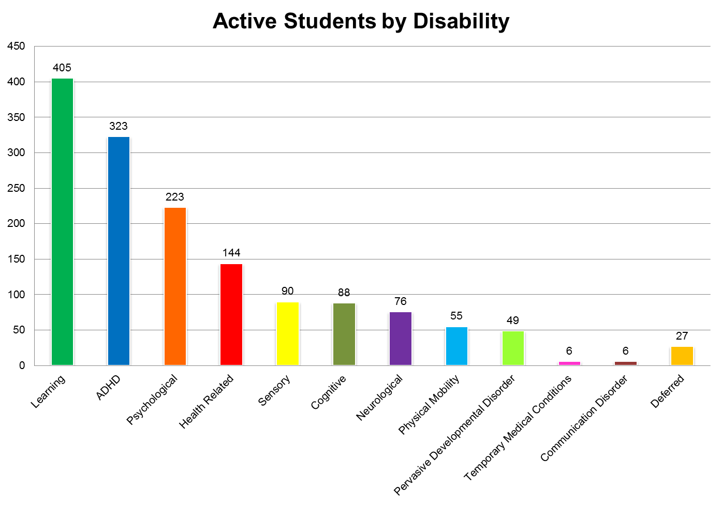
Our Population
Notes:
This chart shows the population breakdown by type of disability that the Office of Accessibility services.
At this time, our largest population of students are those with learning disabilities, followed by students with ADHD, psychological disabilities, and health related conditions.
It should be noted that a majority of the population of students serviced have invisible disabilities that cannot be seen just by looking at the student.
Students who are listed under the “Deferred” category may be receiving provisional accommodations for a semester until their full documentation is received and reviewed.
The following slides break down the types of disabilities further and discuss the impact of these disabilities in the classroom setting.

Slide 10
Reasonable Accommodations
Will not fundamentally alter certain academic or technical standards
Does not substantially alter the fundamental elements of the course, program or service
Does not present an undue hardship
Will not pose a risk to self or others
Notes:
Reasonable accommodations can take many forms. However, an accommodation is not reasonable if it fundamentally alters certain academic or technical standards, substantially alters the nature of the course program, or service, presents an undue administrative or financial hardship, or poses a risk to the student or others.
All students have to meet the same academic requirements. There are no separate classes for students with disabilities, and students with disabilities do not have reduced coursework.

Slide 11
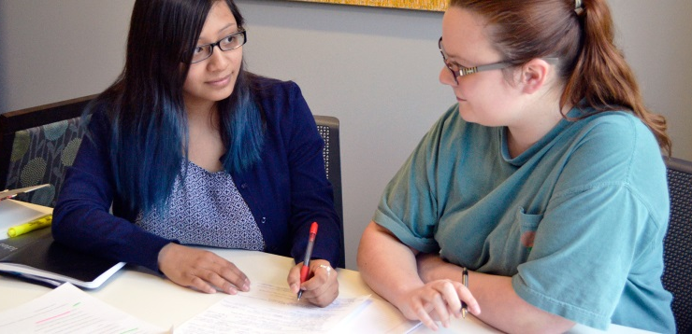
Examples of Reasonable Accommodations
Adaptive Technology
Classroom Accessibility (relocation)
Exam Accommodations (space, time)
Auxiliary Aids (PowerPoint slides)
Equipment (audio recorder)
Transcribers/ Interpreters
Priority Registration
Proctors
Accessible on-campus Housing
Attendance
Notes:
Some examples of reasonable accommodations may include adaptive technology, accessible classrooms, extended testing time and distraction reduced space for testing, copies of powerpoints, use of a tape recorder, use of sign language interpreters, proctors for exams, and attendance. The Office of Accessibility also works with Residence Life and Housing to provide accessible on campus housing accommodations to qualified students.

Slide 12
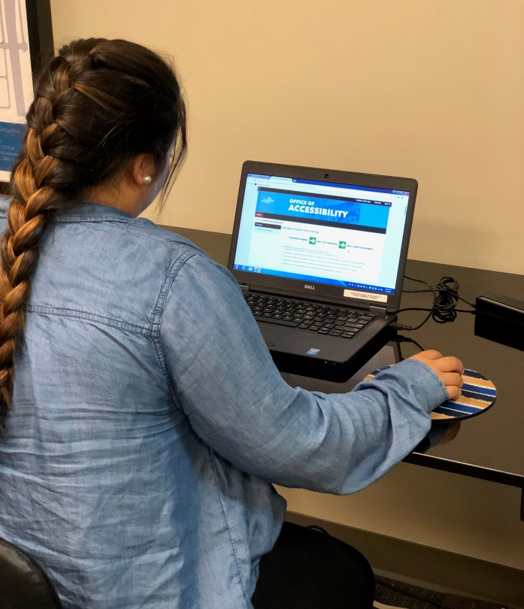
Registration… Easy as 1, 2, 3, 4!!
Complete Online Application
Submit Documentation
Meet with a Disability Specialist
Request Accommodations each semester
Notes:
Students who wish to receive academic accommodations must register with the Office of Accessibility.
The process for registration begins with submitting documentation from a treating practitioner. The office staff will then review the documentation, and the student will come in for an intake appointment, during which they will review appropriate accommodations in the higher education setting, and how these accommodations are implemented.
Following registration, students must request their accommodations each semester in order to receive them.
The office recommends students register at least 3 months prior to their anticipated enrollment, to ensure that the process is complete before classes begin.

Slide 13
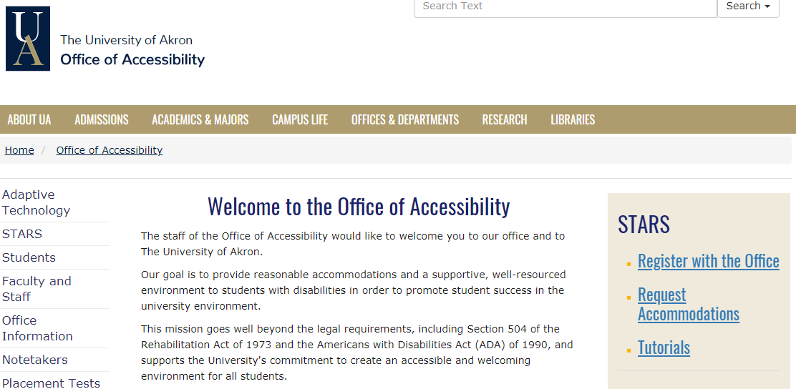
Registration… Easy as 1, 2, 3, 4!!
Complete Online Application
Application completed on the Office of Accessibility’s website: www.uakron.edu/access
Click “Register with the Office” to begin the application process which includes the student’s demographic information as well as how he/she is affected in the classroom
Notes:
Students who wish to receive academic accommodations must register with the Office of Accessibility.
The process for registration begins with submitting documentation from a treating practitioner. The office staff will then review the documentation, and the student will come in for an intake appointment, during which they will review appropriate accommodations in the higher education setting, and how these accommodations are implemented.
Following registration, students must request their accommodations each semester in order to receive them.
The office recommends students register at least 3 months prior to their anticipated enrollment, to ensure that the process is complete before classes begin.

Slide 14
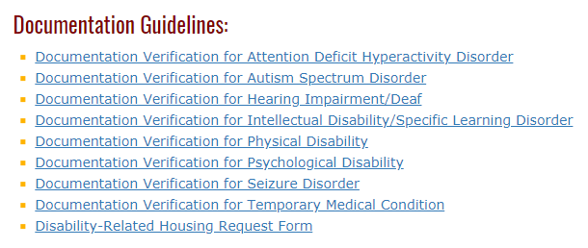
Registration… Easy as 1, 2, 3, 4!!
2. Submit Documentation
Students provide current disability-related documentation
Documentation Guidelines for various disabilities can be found on the Office of Accessibility’s website under “Forms” (see below).
Treating professionals link limitations to accommodation recommendations
The Counseling and Testing Center provides some assessments to current students for reduced cost
Notes:
Students can find documentation guidelines on the Office of Accessibility’s website at www.uakron.edu/access. These forms can be filled out by a doctor and returned to the office.
Some students will have been on an IEP in high school. Students can submit the IEP and accompanying Evaluation Team Report for documentation to review.
If a student has not been tested for a learning disorder or ADHD, but believes they have those diagnosis, the Counseling Center provides testing to current students for a significantly reduced cost.

Slide 15
Registration… Easy as 1, 2, 3, 4!!
Meet with a Disability Specialist
Once a student submits an application and accompanying documentation on the Office of Accessibility’s website, he/she will receive an email regarding the next steps in the registration process
If sufficient documentation has been provided, the student is invited to schedule an Intake appointment with his/her Disability Specialist to set up accommodations and request Accommodation Letters to be sent to appropriate professors.
Notes:
Students who wish to receive academic accommodations must register with the Office of Accessibility.
The process for registration begins with submitting documentation from a treating practitioner. The office staff will then review the documentation, and the student will come in for an intake appointment, during which they will review appropriate accommodations in the higher education setting, and how these accommodations are implemented.
Following registration, students must request their accommodations each semester in order to receive them.
The office recommends students register at least 3 months prior to their anticipated enrollment, to ensure that the process is complete before classes begin.

Slide 16
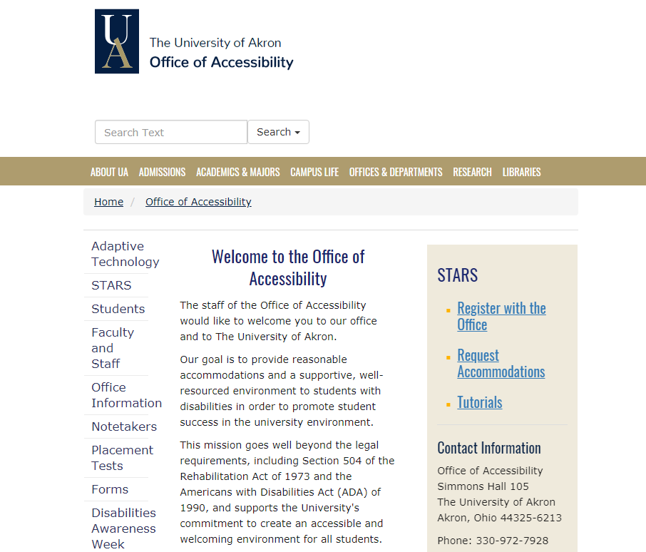
Registration…Easy as 1, 2, 3, 4!!
4. Request Accommodations each semester in The Office of Accessibility’s online system: STARS
Notes:
Each semester, students will use the Office of Accessibility’s online request system, STARS, for their accommodation needs.
Through STARS, students will request accommodation letters to be emailed to their instructors, request exam accommodations, find notetaker information, and download any electronic textbooks that are necessary.
Instructors are also able to use STARS to upload exams that have been requested.

Slide 17
The Office of Accessibility values collaboration between you, your students and our office. Thank you for your time and participation. Office of Accessibility Simmons Hall 105 330-972-7928 www.uakron.edu/access If you would like an electronic copy of this presentation, please feel free to contact the office at access@uakron.edu.
Notes:
The Office of Accessibility welcomes any questions or concerns that faculty and staff have when working with students with disabilities. Please feel free to contact the office to discuss the information in this presentation, or with any other questions or concerns.

Slide 18
Office of Accessibility 101
Office of Accessibility
The University of Akron
Simmons 105
Notes:
Welcome to Accommodations 101: Testing, presented by the Office of Accessibility at The University of Akron.

